Slide 1
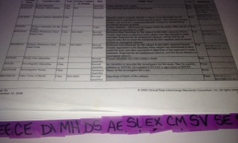
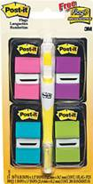
Notes to Instructor
Material Needed
Hard copies of the SDTM IG V3.2 with labelled Post-It notes attached to each domain, or an electronic copy
Each participant will need to bring their laptop to access workshop templates needed to complete workshop exercises
Excel file Exercise Templates and additional electronic resources on the External SharePoint site:

Slide 2
Electronic Documents Required
Lilly Workshop Mod5.pptx (this power point)
Participants will need the following for exercises:
Lilly Mod 5 Exercise.xlsx
Blood Chemistry CRF.png
Core_SDTM_LB_V3.xlsx
For Reference:
ct_vl_global_library.xls
NCI SDTM Controlled Terminology

Slide 3
Lilly Workshop Module 5 SDTM Findings Domains

Slide 4
Objectives
Encourage participation to enhance learning in this hands-on workshop
Provide an overview of the Findings Class and key Findings domains
Provide an introduction to Timing Variables
Participants will map data from a CRF to a SDTM domain
Participants will create a CDISC compliant SDTM LB domain using raw study data

Slide 5
Objectives
Encourage participation to enhance learning in this hands-on workshop
Provide an overview of the Findings Class and key Findings domains
Participants will map data from a CRF to a SDTM domain
Participants will create a CDISC compliant SDTM LB domain using raw study data

Slide 6
Findings Domains

Slide 7
Class: Findings
The Findings class captures the observations resulting from planned evaluations to address specific tests or questions such as laboratory tests, ECG testing, and questions listed on questionnaires
EG
ECG Test Results
LB
Laboratory Test Results
Questionnaires
QS
MB
Microbiology Specimen
VS
Vital Signs
PC
PK Concentrations
IE
Inclusions/Exclusion Criteria Not Met
PE
Physical Examination
Subject Characteristics
SC
MS
Microbiology Susceptibility Test
DA
Drug Accountability
PP
PK Parameters

Slide 8

Findings and Type of Variables
Topic Variable xxTESTCD
Laboratory Test Results (LB) example
Original results and standardized results
Variable | Label | Type | Example
LBTESTCD | Lab Test or Examination Short Name | Topic | ALB
LBTEST | Lab Test or Examination Name | Synonym Qualifier | Albumin
LBORRES | Results or Findings in Original Units | Result Qualifier | 30
LBORRESU | Original Units | Variable Qualifier | g/L
LBSTRESC | Character Results/Findings in Std Format | Result Qualifier | 3.0
LBSTRESN | Numeric Results/Findings in Std Format | Result Qualifier | 3.0
LBSTRESU | Standard Units | Variable Qualifier | g/dL
Notes:
All Findings domains contain the variable xxTESTCD. This is a Findings specific variable: it is not found in other observation classes.
Findings domains contain 2 types of results “original” (as collected) and ‘standardized’ (converted/calculated if needed)

Slide 9
Reference Ranges in Some Findings
LBORNRLO: Lower Limit in Original Units
LBORNRHI: Upper Limit in Original Units
LBSTNRLO: Lower Limit in Standard Units
LBSTNRHI: Upper Limit in Standard Units
LBNRIND: Reference Range Indicator
LBTESTCD | LBTEST | LBCAT | LBORRES | LBORRESU | LBORNRLO | LBORNRHI
ALB | Albumin | CHEMISTRY | 30 | g/L | 35 | 50
WBC | Leukocytes | HEMATOLOGY | 5.9 | 10^9/L | 4 | 11
LBSTRESC | LBSTRESU | LBSTNRLO | LBSTNRHI | LBNRIND
3.0 | g/dL | 3.5 | 5 | LOW
5.9 | 10^9/L | 4 | 11
Notes:
Notice there are variables for ranges in both original and standardized units.

Slide 10

Findings: xxCAT and xxSCAT Examples
LBCAT: Category of Lab Test
HEMATOLOGY
URINALYSIS
CHEMISTRY
LBSCAT: Subcategory of Lab Test
LIVER FUNCTION
ELECTROLYTES
THYROID FUNCTION
Notes:
The values of LBSCAT are all different types of Blood Chemistry Panels (a collection of specific tests).
xxCAT and xxSCAT are NOT specific to Findings domains.
Note: As of Apr2015, Lilly does not utilize xxSCAT in LB.

Slide 11
Timing Variables and Other General Variables

Slide 12
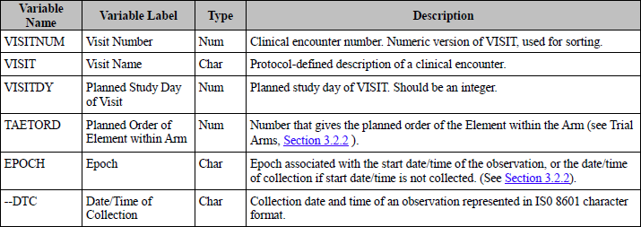

Timing Variables for All Classes
Refer to SDTM V1.4, Section 2.2.5, page 19-21 (subset of full list shown below)
All of the following timing variables are available for use in any domain based on one of the three general observation classes except where restricted in SDTM IG

Slide 13

More on Timing Variables
The variables VISITNUM and xxDTC are typically expected (Exp.) variables in Findings domains
Per “Study Data Technical Conformance Guide, Technical Specifications Document” (CDER/CBER December 2014)
The variable EPOCH should be included for clinical subject-level observation.
This will allow the reviewer to easily determine during which phase of the trial the observation occurred as well as actual intervention the subject experienced during that phase.

Slide 14
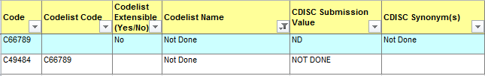
Not Done (xxSTAT)
The record qualifier xxSTAT is a variable in some Interventions, some Events, and most Findings domain classes.
Typically xxSTAT is used when the CRF contains a check box for NOT DONE.
Not Done
Not Done check boxes are different than the following type of Data Management question on a CRF:
Were labs were done at this visit? Yes No

Slide 15
Yes or No? [NOT SUBMITTED]
Were labs done at this visit? Yes No
This type of questions is typically [NOT SUBMITTED] in an SDTM domain. Why?
If the above question is answered “Yes” then lab results are present in the data. And if the above question is answered “No” then lab results are not present in the data. This is used for Data Management purposes.
Note: If Labs Done = N then Lilly maps to LBSTAT
Not all Yes or No questions are the same. How do you know if a Yes or No question needs to be submitted?
Notes:
Lilly takes Y/N and turns them into Not Done
If labs done Y/N? is N, then Lilly creates and LBALL = Not Done
This is also used in conjunction with test Not Done. They do both.

Slide 16
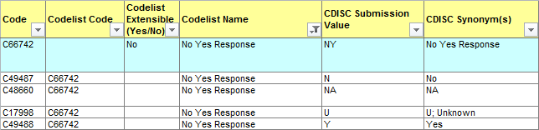
Yes or No (NY) Example
Example: “Was subject fasting?” Yes No
If collected, the above Yes or No questions needs to be include in the LB SDTM domain. Why?
Is the following true? If the above question is answered “Yes” then lab results are present in the data. And if the above question is answered “No” then lab results are not present in the data.
Also consider if the data is needed for analysis, or as a reference.

Slide 17
Closer Look at Some Findings Domains

Slide 18
Vital Signs (VS)
Measurements including, but not limited to, blood pressure, temperature, respiration, body surface area, BMI, height, and weight.
VS Structure: One record per vital sign measurement per time point per visit per subject.
Example Keys (makes a unique record): STUDYID, USUBJID, VSTESTCD, VISITNUM, VSTPTNUM
STUDYID | USUBJID | VSTESTCD | VISIT | VISITNUM | VSTPT | VSTPTNUM
XYZ101 | 1012 | SYSBP | Visit 2 | 2 | Time Point 1 | 1
XYZ101 | 1012 | SYSBP | Visit 2 | 2 | Time Point 2 | 2
Notes:
VS Structure relates to the Keys. (English equivalent or variables).
Note to instructor: Metadata will be introduced in Mod 6.

Slide 19
xxTESTCD and xxTEST
In all Findings domains, there is a one-to-one relationship between the variables xxTESTCD and xxTEST
In VS, VSTESTCD is the Vital Signs Test Short Name
In VS, VSTEST is the Vital Signs Test Name
VSTEST = “Body Mass Index” where VSTESTCD = “BMI”
CTLIST | SUBMISSION_VALUE | DECODE
CL2.VSTEST | Adipose Tissue
CL2.VSTEST | Body Frame Size
CL2.VSTEST | Body Mass Index
CL2.VSTEST | Body Surface Area
CL2.VSTEST | Diastolic Blood Pressure
Notes:
Because of the one to one relationship, codelists are needed for xxTESTCD values.
(Some domains have NCI CT and some are sponsor defined)

Slide 20
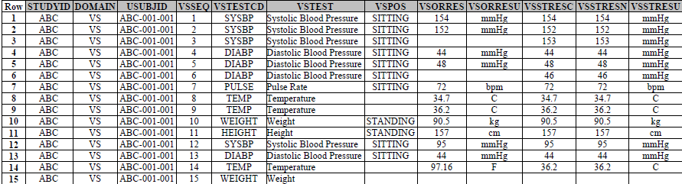
Vital Signs (VS) SDTM IG Example
Required Variables – Must be in domain and cannot be missing a value
Expected Variables – Must be in domain but the value can be missing. Additional expected variables are on next slide
Notes:
Review of a Required vs. and Expected Variable.
Note: Rows where VSORRES is null are either not done or are derived (VSDRVFL = Y), VSSTRESC has a value, VSORRES null. (row for average value at BASELINE)

Slide 21
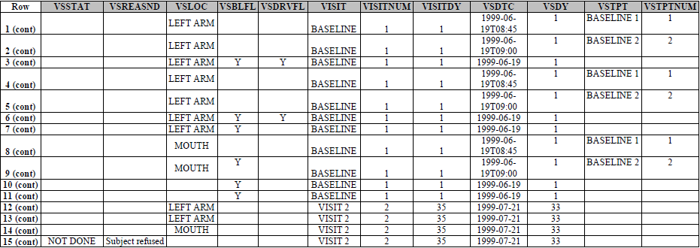
Vital Signs (VS) SDTM IG Example
Expected Variables – Must be in domain but the value can be missing
Permissible Variables – May or may not be included in the domain. If included, values may or may not be missing

Slide 22
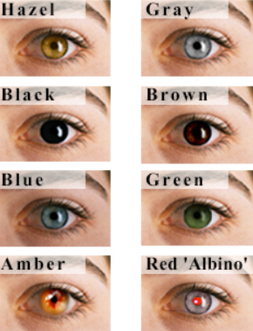
Subject Characteristics (SC)
Subject Characteristics is used to capture data about a subject that is not included in Demographics
Typically this is data that is not expected to change and it is only captured one time
Examples:
Subject Initials
Eye Color
Childbearing status

Slide 23
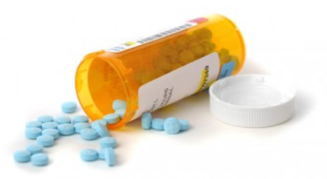
Drug Accountability (DA)
Data regarding the accountability of study drug, such as information on the receipt, dispensing, return, and packaging
Example DA data set
What variables below are subject to controlled terminology?
USUBJID | DATESTCD | DATEST | DACAT | DASCAT | DAORRES | DAORRESU
1001 | DISPAMT | Dispensed Amount | Study Medication | Bottle A | 30 | TABLETS
1001 | RETAMT | Returned Amount | Study Medication | Bottle A | 5 | TABLETS
Notes:
Answer: Lilly = DATEST/CD, DACAT, DASCAT
NCI_CT = DAORRESU

Slide 24

Questionnaires (QS)
The name of the questionnaire should be described in the variable QSCAT
Each question is recorded in QSTESTCD/QSTEST and the original CRF result recorded in QSORRES
Questionnaires are typically scored. If “Total Score” is derived, set variable QSDRVFL = “Y”
USUBJID | QSTESTCD | QSTEST | QSCAT | QSORRES | QSSTRESC | QSDRVFL
1002 | HAMD101 | HAMD1-Depressed Mood | HAMD 17 | Absent | Absent
1002 | HAMD1_ _ | … | HAMD 17 | … | …
1002 | HAMD118 | HAMD1-Total Score | HAMD 17 |  | 18 | Y

Slide 25
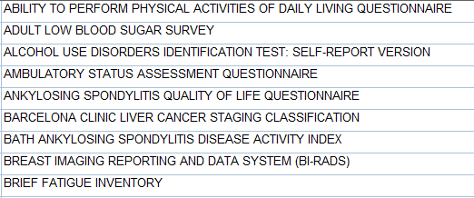

Types of Questionnaires @ Lilly
There are over 80 different questionnaires used at Lilly, with a total of over 2,300 questions
What is the best way to keep track of which questions go with which questionnaires?
Example Questionnaires:
Notes:
Questionnaires is a large topic. Sponsor questionnaires, copyrighted questionnaires, etc.
There is a large volume of CT for QS. There is a separate document that houses the NCI_CT for QS.
Answer: Subset of allowed QSTESTCDs by QSCAT. (INFO only: Valuelevel metadata which is beyond the scope of this training), or include name or code of questionnaire in QSTEST/QSTESTCD

Slide 26
Lilly Module 5 Exercise #1

Slide 27
Group Exercise #1
Resources:
Use “Lilly Mod 5 Exercise” template (Lilly Mod 5 Ex. 1 tab)
Blood Chemistry CRF.png
SDTM IG v3.2
Exercise:
Based on the Blood Chemistry CRF,
Determine an appropriate domain name and determine how the variables on the CRF map to SDTM variables.
Which variables have Controlled Terminology?
Notes:
Have students open the exercise and the CRF. Go to the next slide which is the CRF

Slide 28
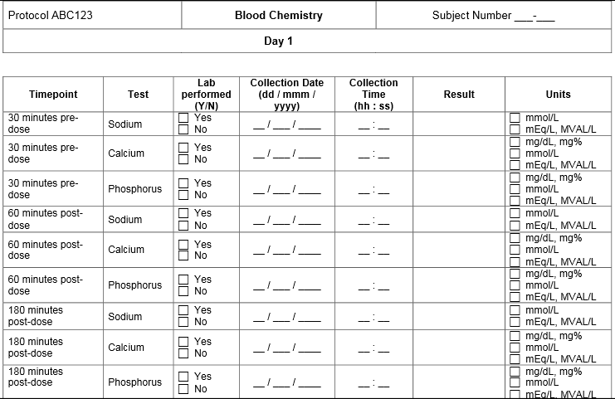
Exercise #1 – Blood Chemistry CRF
Open the Mod 5 Ex. 1 spreadsheet or use a hard copy of the CRF
Phosphate
Phosphate
Phosphate
Notes:
Exercise: Together the variables on the CRF will be mapped to their SDTM variables, and we will determine which use CT. Advance to next slide which will walk the students through step by step.

Slide 29
Exercise #1 – Step by Step
Determine the name of the domain
Identify the SDTM variables needed to capture the data from this CRF.
Notes:
Instructor: use a white board to capture the answers as the class goes through the exercise.

Slide 30
Exercise #1 – Blood Chemistry CRF
Phosphate
Phosphate
Phosphate
Notes:
Instructor: use this slide to get answers from the participants for each SDTM variable that can be mapped from this CRF.
Use white board if needed to collect answers

Slide 31
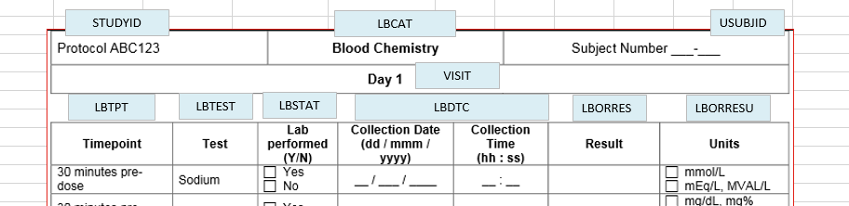
Exercise #1 –Answer

Slide 32
Exercise #1 – Step by Step
Determine the name of the domain
Identify the SDTM variables needed to capture the data from this CRF.
Determine if the variables are Required, Expected, or Permissible per the SDTM IG.
Notes:
Use White Board with 3 columns of variable roles: Exp, Req, Perm. Have students open the IG to determine the Core.

Slide 33
Exercise #1 –Answer

Slide 34
Exercise #1 – Step by Step
Determine the name of the domain
Identify the SDTM variables needed to capture the data from this CRF.
Determine if the variables are Required, Expected, or Permissible per the SDTM IG.
Which of these variables has Controlled Terminology?
Notes:
Use White Board and mark those w/ CT

Slide 35
Exercise #1 –Answer

Slide 36
Exercise #1 – Step by Step
Determine the name of the domain
Identify the SDTM variables needed to capture the data from this CRF.
Determine if the variables are Required, Expected, or Permissible per the SDTM IG.
Which of these variables has Controlled Terminology?
Does the data captured on this CRF contain all the variables needed to create a SDTM compliant dataset?

Slide 37
Exercise #1 –Answer
There are additional Required and Expected variables per the IG (e.g. DOMAIN, LBSEQ,
LBTESTCD, etc.)

Slide 38
Lilly Module 5 Exercise #2

Slide 39
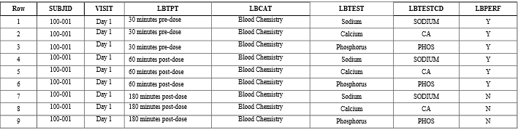
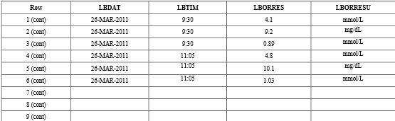
Lilly Mod 5 Exercise #2
Using the RAW data below what would you change (add/modify/delete) to create a CDISC compliant SDTM LB domain?
LBSEQ
Phosphate
Phosphate
Phosphate
LBSEQ
Notes:
A copy of the dataset is in the exercises tab.
Go to next slide to get the students going

Slide 40
Exercise #2 – Step by Step
Open Lilly Mod 5 Exercise spreadsheet, Ex. 2 tab, which contains the raw dataset
List the variables that need to be added to make the dataset CDISC SDTM compliant (Open the SDTM IG, column Core)
List the variables that need to be added to make the dataset Lilly compliant (Open Core_SDTM_LB_v3, Variable_Required)
List the variables that should be renamed/remapped.
What variables have values that need to be modified?
Hint: Are the variables with controlled terminology using the correct CT?
List the variables that should be deleted from the SDTM dataset.
Go Back
Notes:
Read the instructions, leave this slide up and walk around the room to help trainees.

Slide 41
Exercise #2 – Answer
Add variables needed to be to make the dataset CDISC compliant?
Add variables needed to be to make the dataset Lilly compliant?
Notes:
Use white board to capture answers………
Note: EPOCH and –DY are at FDA request as well.
LBNRIND left up to sponsor to determine if indicator based on ORRES or STRESC/N.

Slide 42
Exercise #2 – Answer Continued
List the variables that should be renamed/remapped.
What variables have values that need to be modified?
List the variables that should be deleted.

Slide 43
Summary
The Findings class captures the observations resulting from planned evaluations to address specific tests or questions such as laboratory tests, ECG testing, and questions listed on questionnaires
Timing variables are available for use in any domain based on one of the three general observation classes except where restricted in SDTM IG
Findings CRFs must collect a test topic variable, xxTESTCD, as well as an original test results variable, xxORRES, and a standardized test results variable, xxSTRESC

Slide 44
Summary
The Findings class captures the observations resulting from planned evaluations to address specific tests or questions such as laboratory tests, ECG testing, and questions listed on questionnaires
Findings Domains must collect a test topic variable, xxTESTCD, as well as an original test results variable, xxORRES, and a standardized test results variable, xxSTRESC

Slide 45
End of Lilly Module 5 ☺

